Slide 1
CSE7302 - INTERNSHIP Review-3 Presentation AI/ML INTERNSHIP
Student Details
Name | Vibha Binoy Sasidharan
Roll No | 20221IST0020
Section | 8IST01
Under the Supervision of,
Mr. Jinesh VN
Assistant Professor
Presidency School of CSE
Presidency University
Name of the Program: Information Science And Technology(AI and DS)
Name of the HoD: Dr. Pallavi R
Name of the Program Internship Coordinator: Mr. Saptarsi Sanyal
Name of the School Internship Coordinator: Dr. Md Ziaur Rahman

Slide 2
Content
About Company or Organization
Working domain or the technology
About your team and reporting Manager
Challenges Faced in Internship
Objectives of the work
Literature Review
Proposed System
Problem Statement
System Requirements
Advantages of Proposed System/Work
System Design
System Implementation
Internship Roadmap
Github Link

Slide 3
About Company or Organization
Accion Labs is a global Cloud Engineering and Innovation company focused on helping enterprises transform their business using emerging technologies.
The company specializes in digital transformation, cloud modernization, data engineering, and AI-driven solutions.
It has a global presence with 4,400+ engineers across 23 locations worldwide, grown through organic expansion and strategic acquisitions.
The organization emphasizes quality, innovation, and continuous improvement to solve complex business problems.

Slide 4
Working domain or the technology
The assigned domain is Data Engineering and Data Quality Testing using Python.
The project involves building a data testing solution that connects to multiple data sources and validates business logic through automated tests.
The solution is implemented completely in Python with API endpoints to enable scalable, reusable, and automated data validation workflows.

Slide 5
About your team and reporting Manager
I am part of a Data / AI Engineering team, working on a Python-based data testing solution.
Currently, I work closely with a mentor who guides me through project understanding, tasks, and best practices.
I report to the Technical Lead of the team, who oversees the project progress and provides technical direction.

Slide 6
Challenges Faced in Internship
Finding a suitable internship opportunity aligned with AI/ML interests.
Understanding the project workflow and tools during the initial days.
Adapting to a professional work environment

Slide 7
Objectives of the work
To understand the fundamentals of AI and Machine Learning in an industry environment.
To gain hands-on exposure to data processing and basic model development.
To learn the AI/ML workflow and best practices followed at Accion Labs.
To work with mentors and understand real-world problem-solving using AI.

Slide 8
Literature Review
Python and Flask are widely used for backend development and API creation
ETL processes are commonly used for efficient data transformation and storage
Parquet format is optimized for handling large-scale structured data
SQL Server is widely used for reliable and structured data management
Modern applications use API-based architecture for seamless system integration

Slide 9
Proposed System / Work
Designed a data pipeline application to process Parquet files and store data in SQL Server
Developed backend APIs using Flask to handle file upload and data processing
Implemented ETL process: Extract data from Parquet, Transform data, and Load into database
Created a user interface using HTML and Jinja templates for interaction
Enabled integration between frontend, backend, and database systems
Performed API testing using Postman to validate request-response functionality
Ensured efficient data handling with proper validation and error handling

Slide 10
Problem Statement
Manual processing of large data files is time-consuming and error-prone
Lack of an automated system to convert Parquet files and store data in databases
Difficulty in efficiently performing data transformation and integration
Need for a user-friendly system to handle file upload and data processing

Slide 11
System Requirements
Hardware: Laptop/PC with minimum 8GB RAM and stable internet connection
Software: Python, Flask framework, SQL Server, Visual Studio Code
Frontend: HTML, Jinja Templates for user interface
Tools: Postman for API testing
Other: Web browser (Chrome) for application testing

Slide 12
Advantages of Proposed System/Work
Automates data processing, reducing manual effort and errors
Efficient handling of large Parquet files using ETL process
Seamless integration between frontend, backend, and database
Faster and reliable data insertion into SQL Server
User-friendly interface for easy file upload and processing

Slide 13
System Design
System follows a three-layer architecture: Frontend, Backend, and Database
Frontend developed using HTML and Jinja templates for user interaction
Backend implemented using Flask APIs for processing and logic
Data pipeline performs ETL: Extract from Parquet, Transform, Load into SQL Server
REST APIs enable communication between frontend and backend

Slide 14
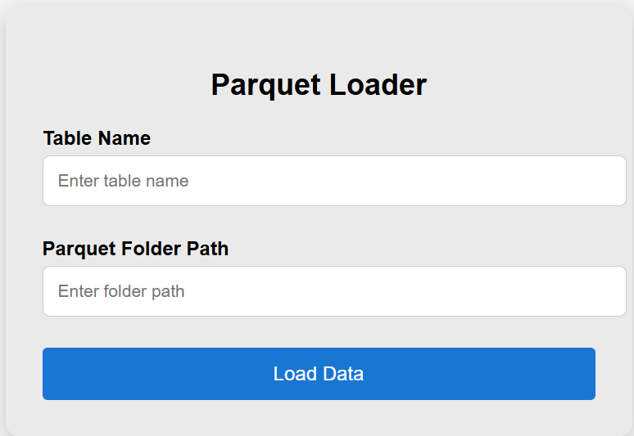
System Implementation (At least 50%)

Slide 15
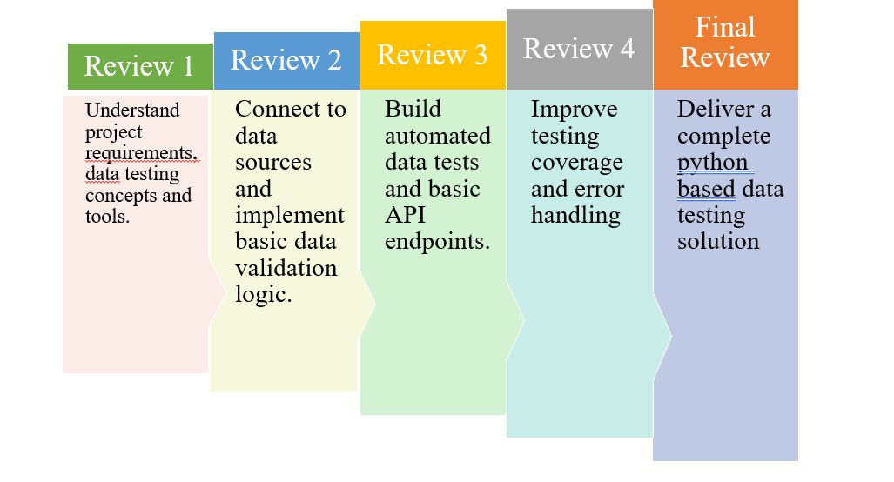
Internship Road Map

Slide 16
Github Link
https://github.com/VibhaBinoy

Slide 17
Q&A

Slide 18
Thank you !!

